Slide 1


Machine Learning for Reservoir Inflow Temperature Prediction in water resources management models
WORLD ENVIRONMENTAL & WATER RESOURCES CONGRESS
MINNEAPOLIS, MINNESOTA| JUNE 3–7, 2018
ELLIE WHITE, Graduate Student, elawhite@ucdavis.edu
JOHN DEGEORGE, Principal & Project Manager at RMA, jfdegeorge@rmanet.com
DONALD SMITH, President at RMA, don@rmanet.com
STEPHEN ANDREWS, Senior Water Resources Engineer at RMA, steve@rmanet.com
This material is based upon work partly supported by the NSF GRFP under Grant No. 1650042 & the Climate Change, Water, and Society NSF IGERT, to UC Davis DGE No. 1069333.
Any opinion, findings, and conclusions or recommendations expressed in this material are those of the authors(s) and do not necessarily reflect the views of the National Science Foundation.

Slide 2
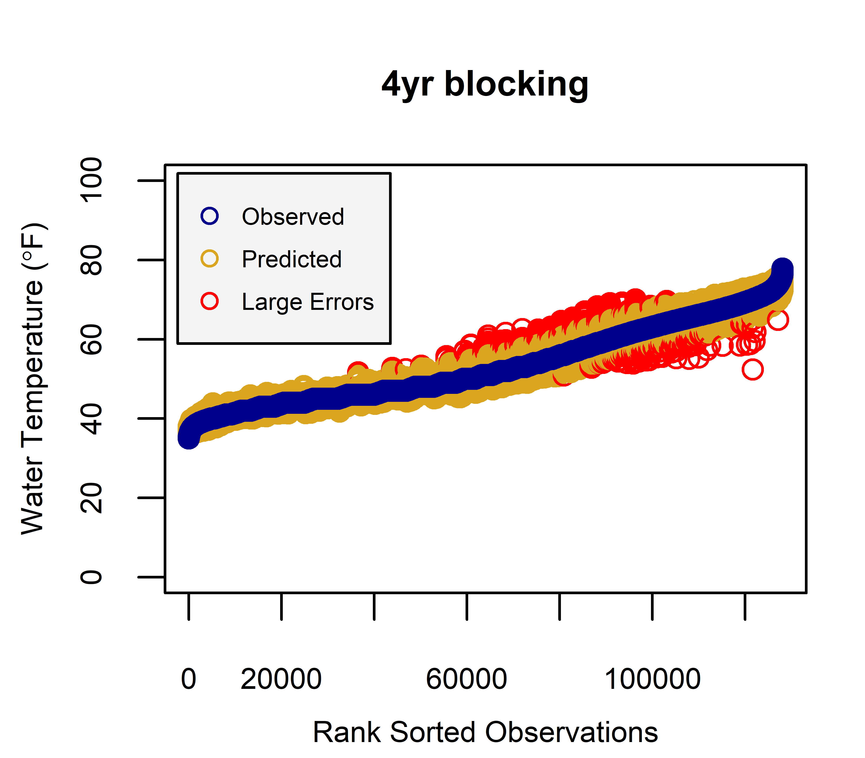
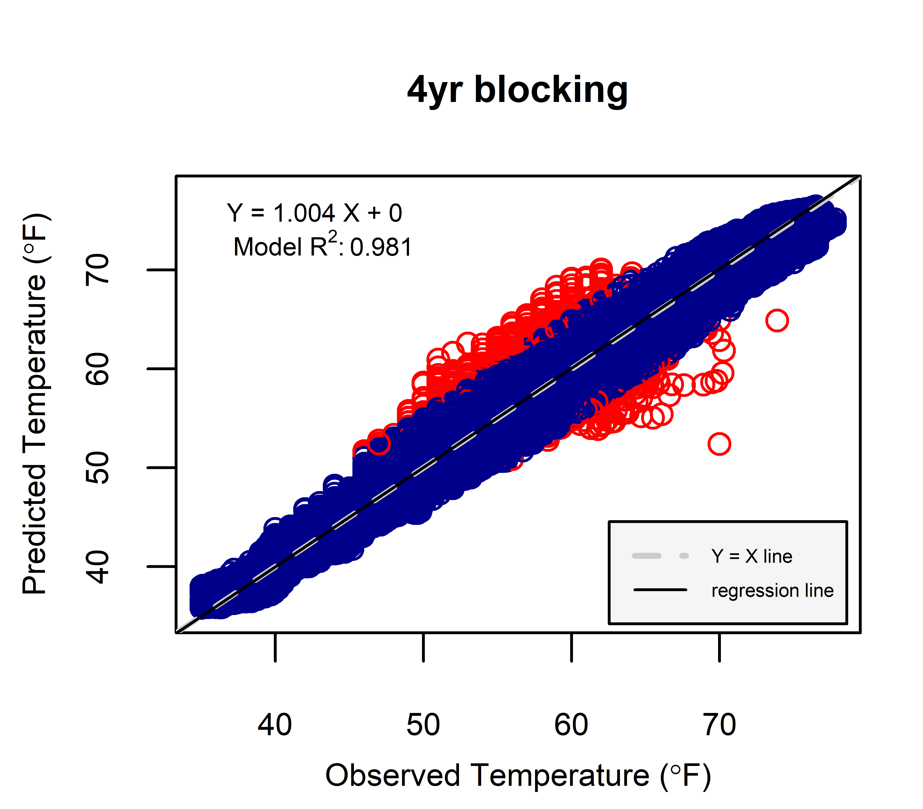
Results: Sacramento R.

Slide 3

Introduction
“We are drowning in data and starving for knowledge” –Rutherford D. Roger
Temperature models:
mechanistic (process-based)
empirical (statistical)
Aim: predict the hourly streamflow temperatures
Make accurate predictions using random forests (empirical model)
by J. J. SEMPÉ
Notes:
Traditional temperature models are physically based; given user described system characteristics (e.g., channel geometry, slope, flow, climate conditions), they use governing equations for heat conservation and fluid flow to predict water temperatures.
Without a unifying approach, and considering the increasing availability of environmental data, there is merit in the more economical predictive power of statistical models.
We can then use these statistical models in managing complex natural resource systems.

Slide 4

Research Questions
Q1) Can machine-learning models give better and more cost effective streamflow temperature predictions for drought, flood and water management applications compared to mechanistic models?
Q2) What will be the relative importance of variables that contribute to temperature predictions?
by J. J. SEMPÉ

Slide 5
Method
Input Data
- - - - - - - - - - - - - - - - -
Response| Predictor
Missing Data
Fixing Dubious Data
Test
Train
Future Predictions
can be applied to
ML Model
Ungauged Basins
ML Prediction
Measures of Fit
Notes:
We just have to be careful: using statistical models for extrapolation involves some risk and they shouldn’t be strained too much beyond their limits.

Slide 6
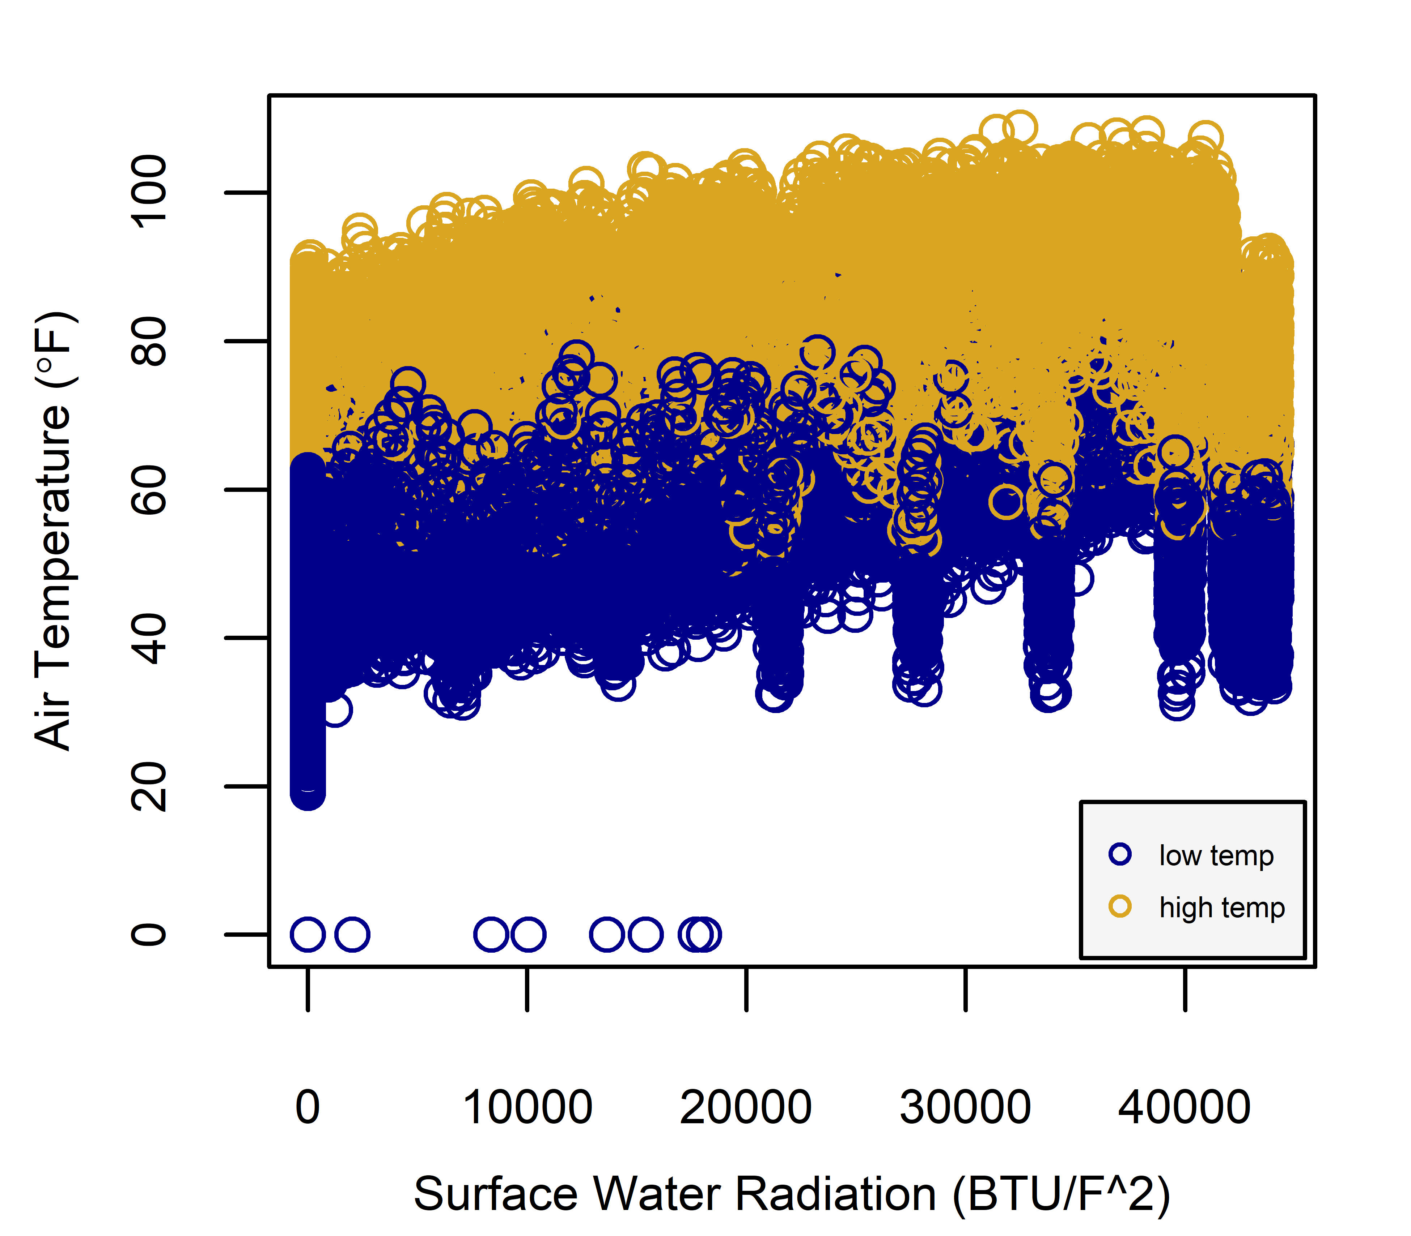
ML Models
?
In machine learning, computers apply statistical learning techniques to automatically identify patterns in data.
Machine learning methods use statistical learning to identify boundaries and patterns in the data.
One example of a machine learning method is a decision tree. Decision trees look at one variable at a time.
?

Slide 7
Method
Input Data
- - - - - - - - - - - - - - - - -
Response| Predictor
Missing Data
Fixing Dubious Data
Test
Train
Future Predictions
can be applied to
ML Model
Ungauged Basins
ML Prediction
Measures of Fit
Notes:
We just have to be careful: using statistical models for extrapolation involves some risk and they shouldn’t be strained too much beyond their limits.

Slide 8
Cross-Validation Splitting

Slide 9
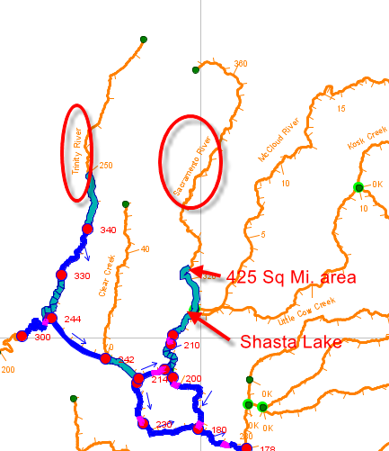
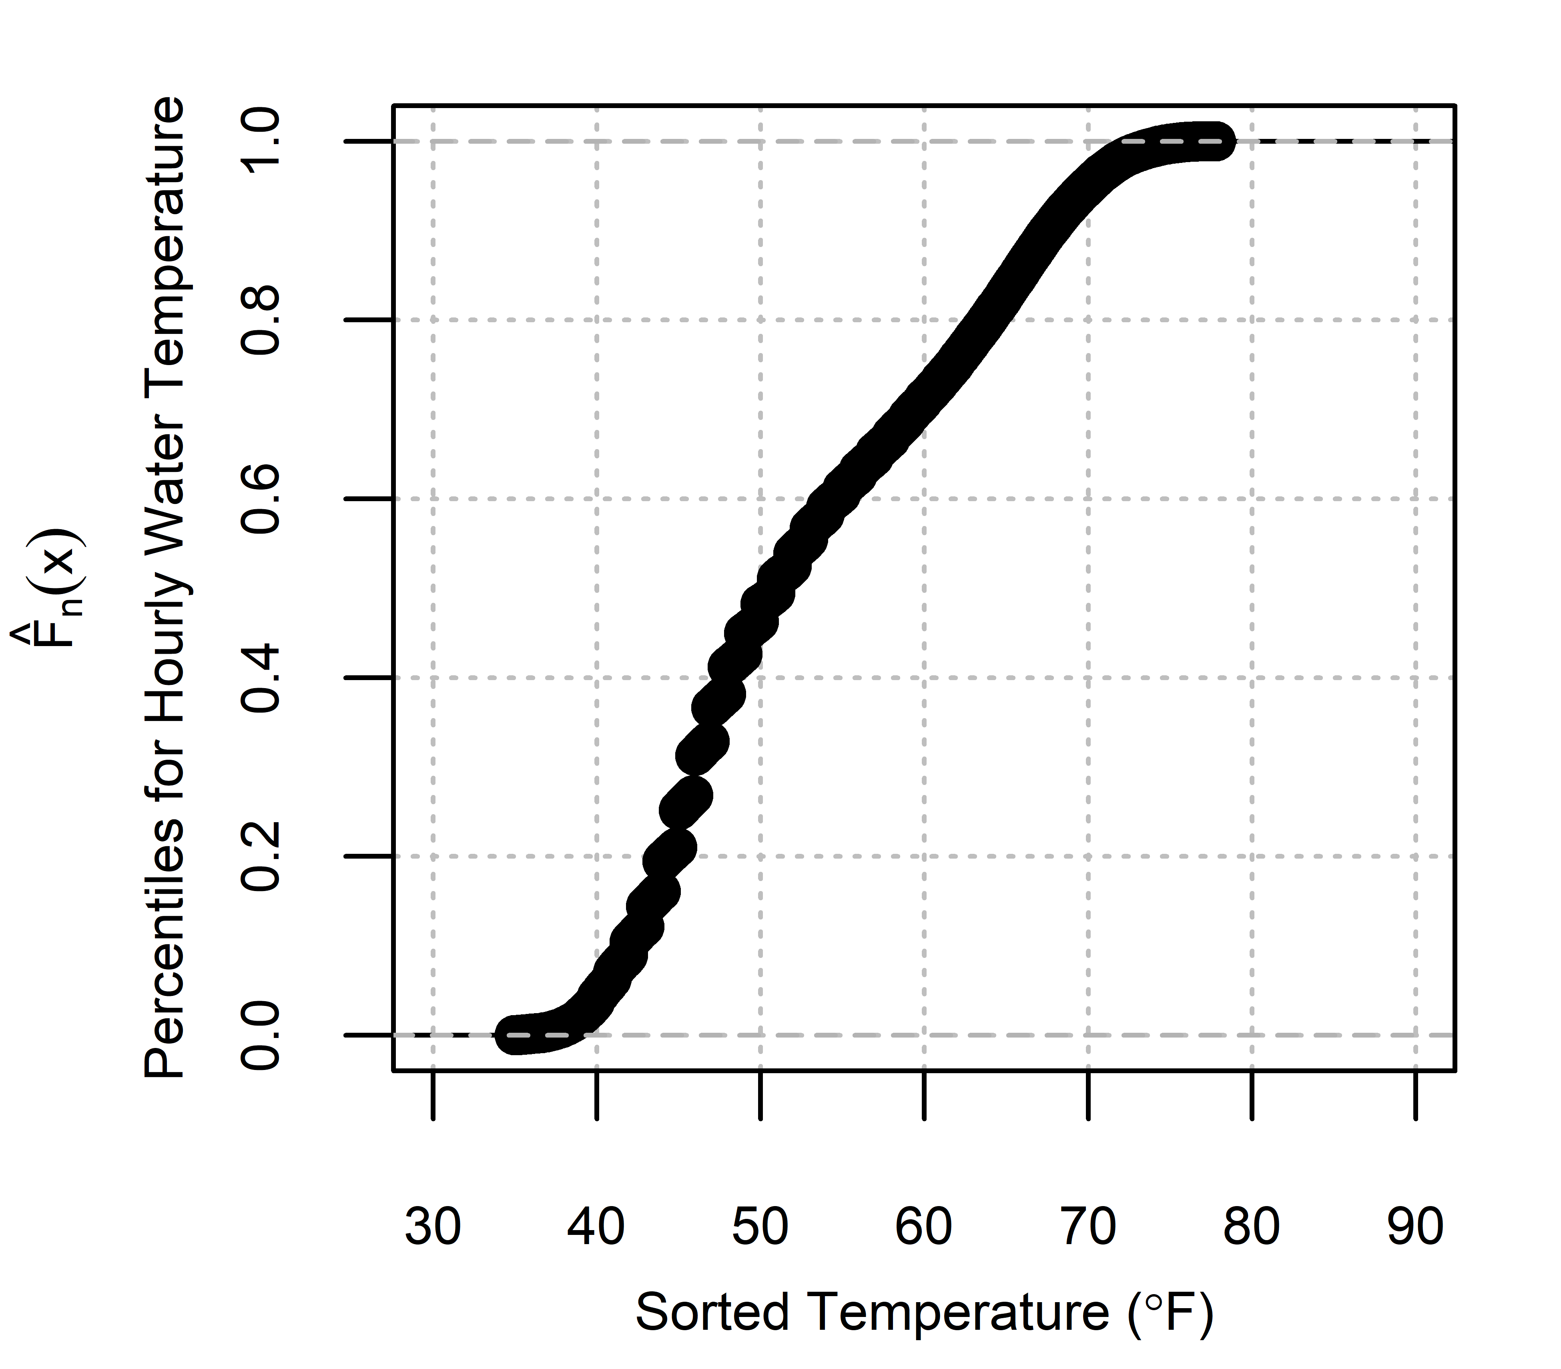
Input Data: Response Variable
Hourly streamflow temperature from California Data Exchange Center (CDEC)
# CA basins later, now just the Sacramento River above Shasta Lake
2002-2017
128,097 instances

Slide 10
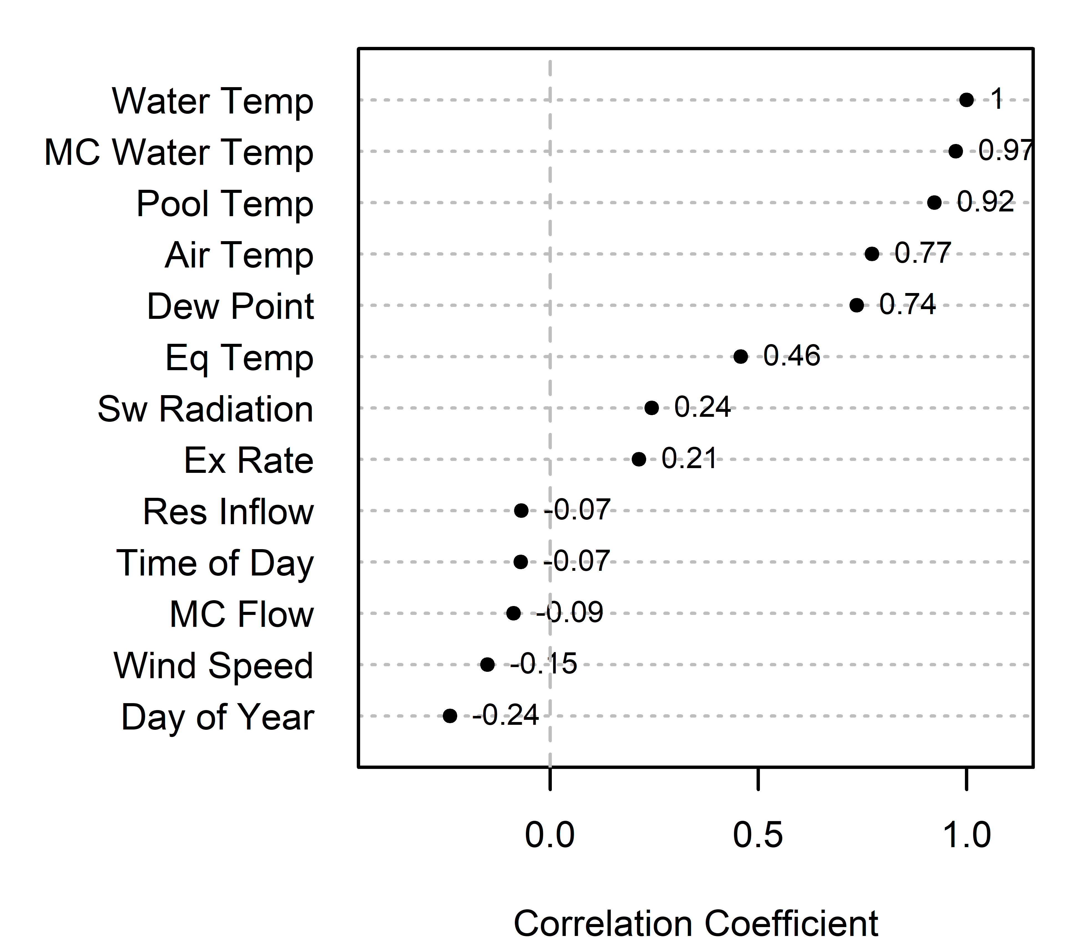
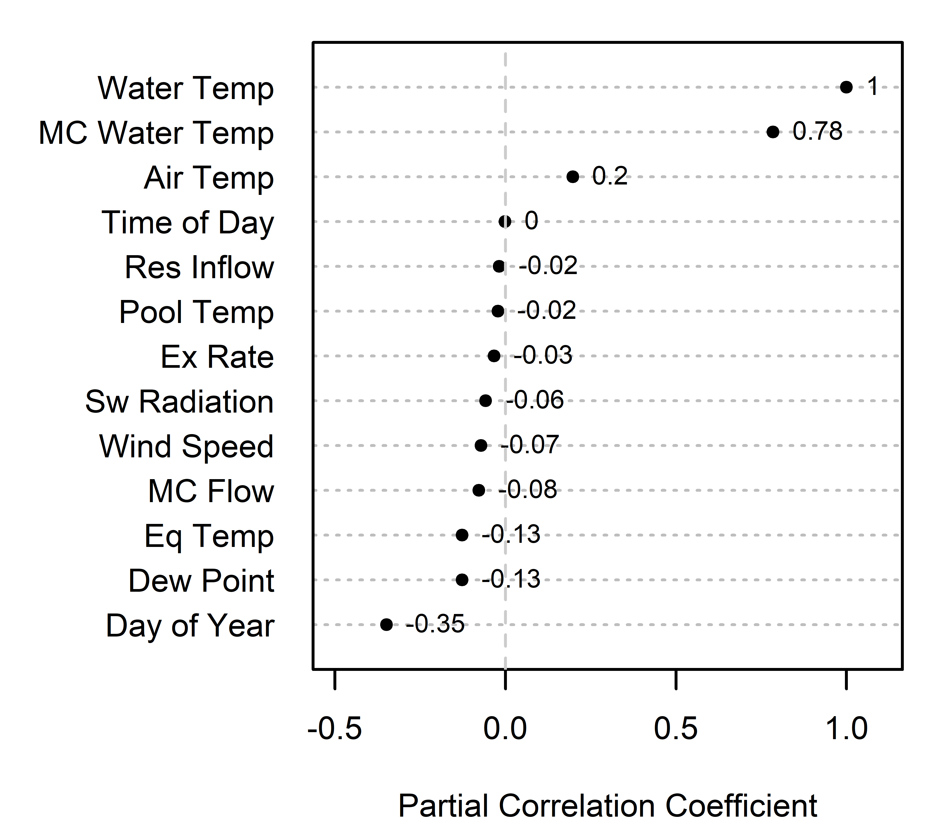
Input Data: Predictor Variables
Describe how each one was calculated
Notes:
Before we look at building the model, we can inspect the data. Here are the correlation values of the predictor variables vs. the response variable. These correlation values can provide hints as to what variables we will expect to see become important in the machine learning model.

Slide 11
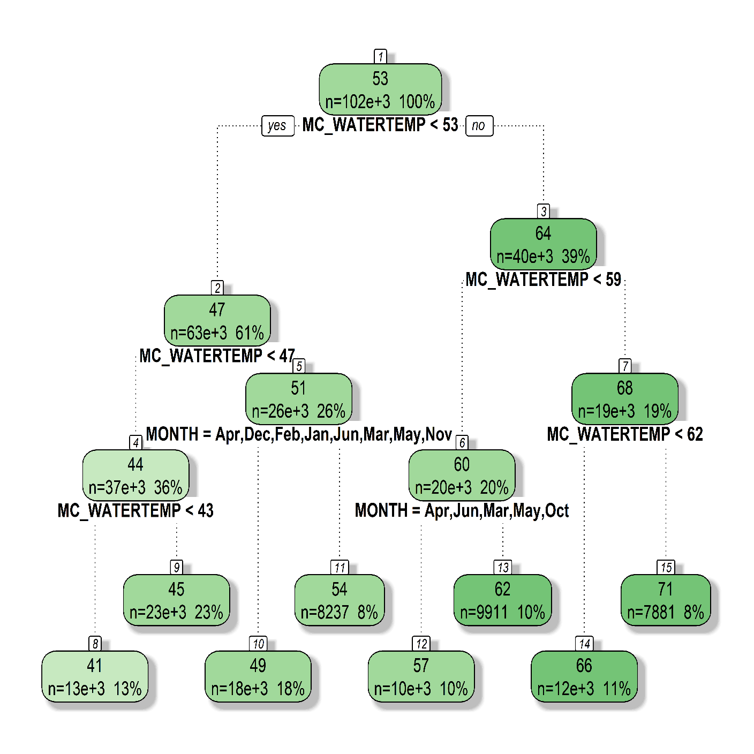
Model: Classification & Regression Tree (CART)
streamflow temperature
prediction
Notes:
CART gives us a nice tree to look at but it doesn’t do well on predicting a continuous variable. So … we move on to RF model.

Slide 12
Model: Random Forest
streamflow temperature
prediction
Notes:
RFs grow a lot of trees, and by injecting randomness in the CART the trees look different, where does this randomness come in? in two places, one in the number of predictor variables the tree is allowed to make a split on at each node, so instead of the full range of predictor variables it’s only allowed to look at a subset. And two at each node the tree is allowed to make the best split by looking at only 2/3rds of the set. So a random 1/3 of the data set is held out at each node.
This allows for the model to grow trees that are uncorrelated. Why? Because let’s say you have a strong predictor variable, if you allow the trees to make a split based on whatever variables it wants, they will all chose that strong predictor, and therefore the trees in the forest end up looking somewhat alike.

Slide 13
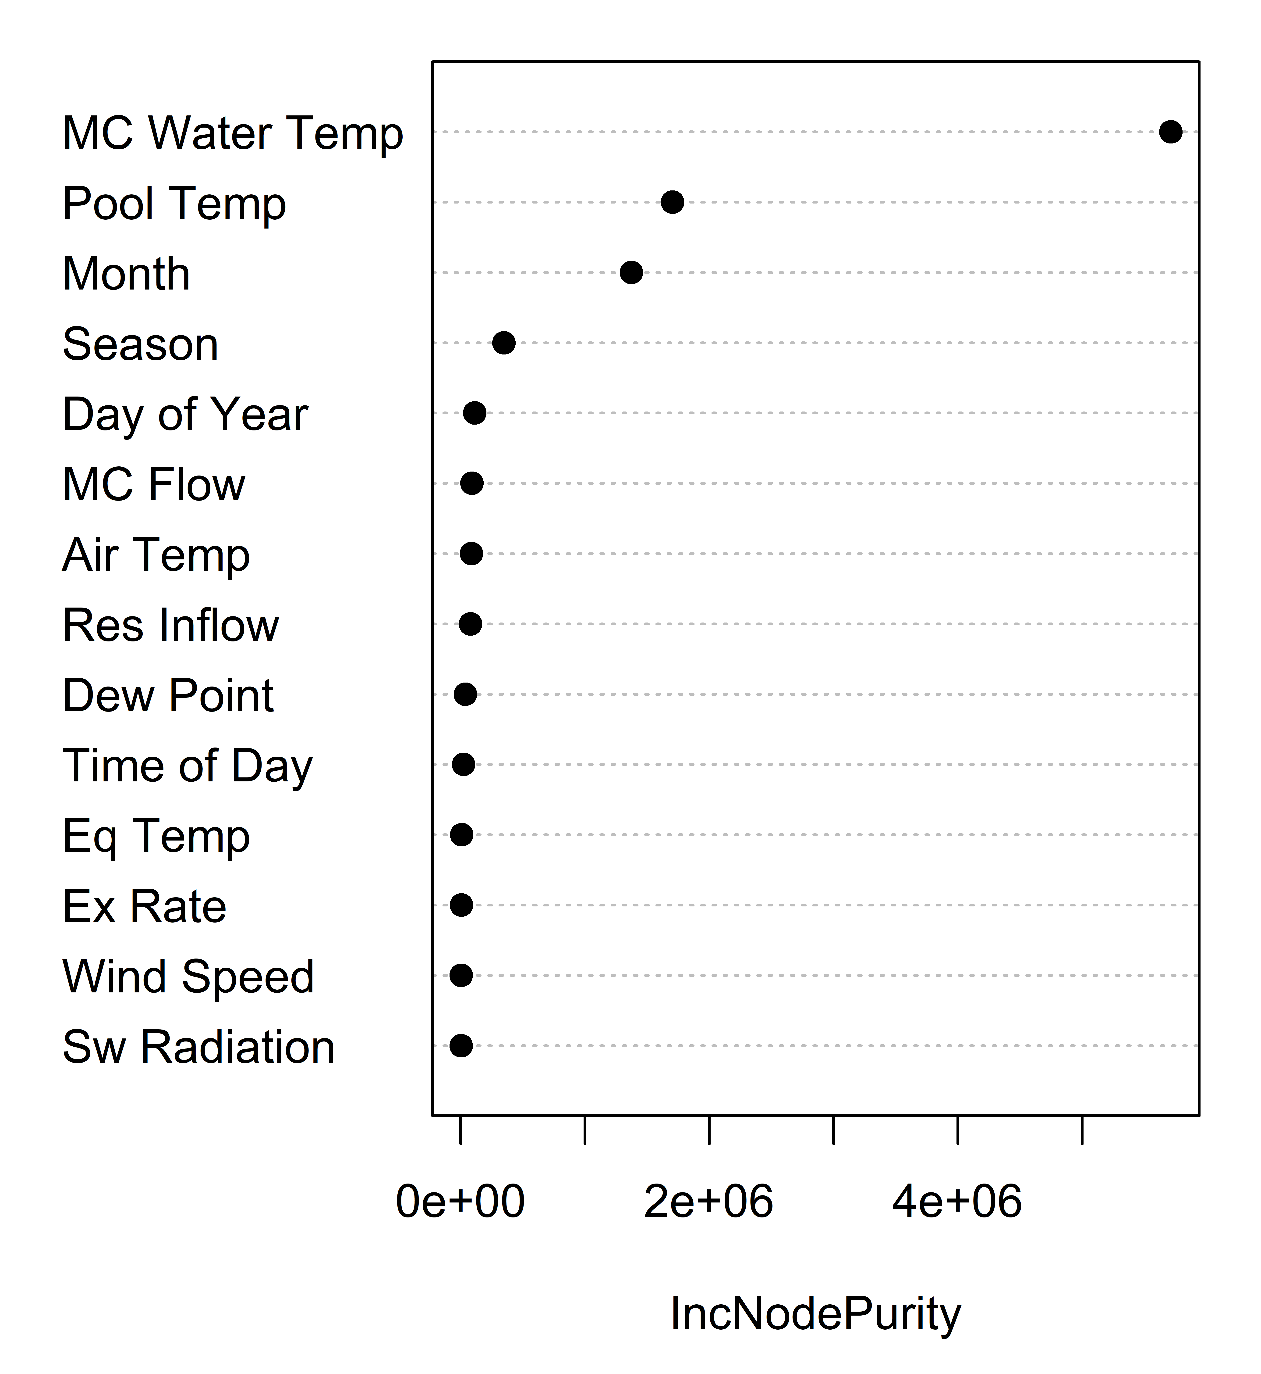
Results: Random Forest
Q2) What will be the relative importance of variables that contribute to temperature predictions?
Goodness of Split

Slide 14
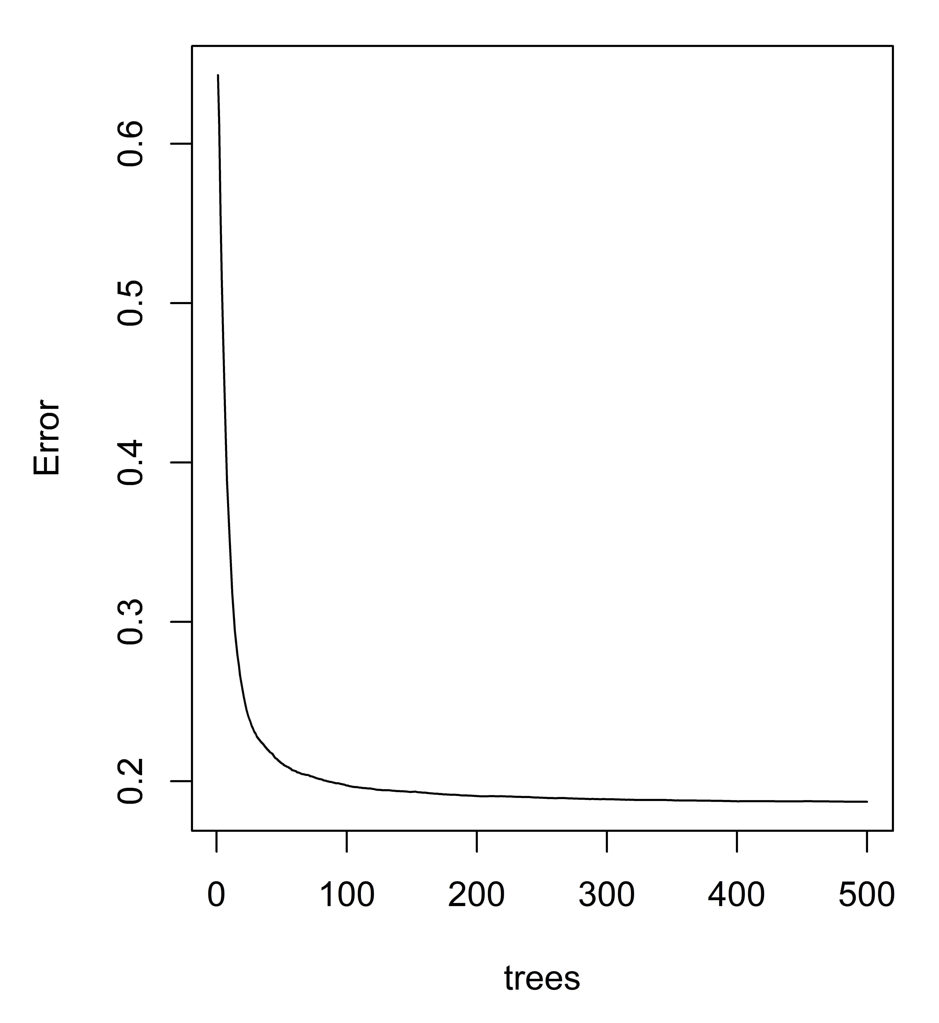
Results: Random Forest

Slide 15
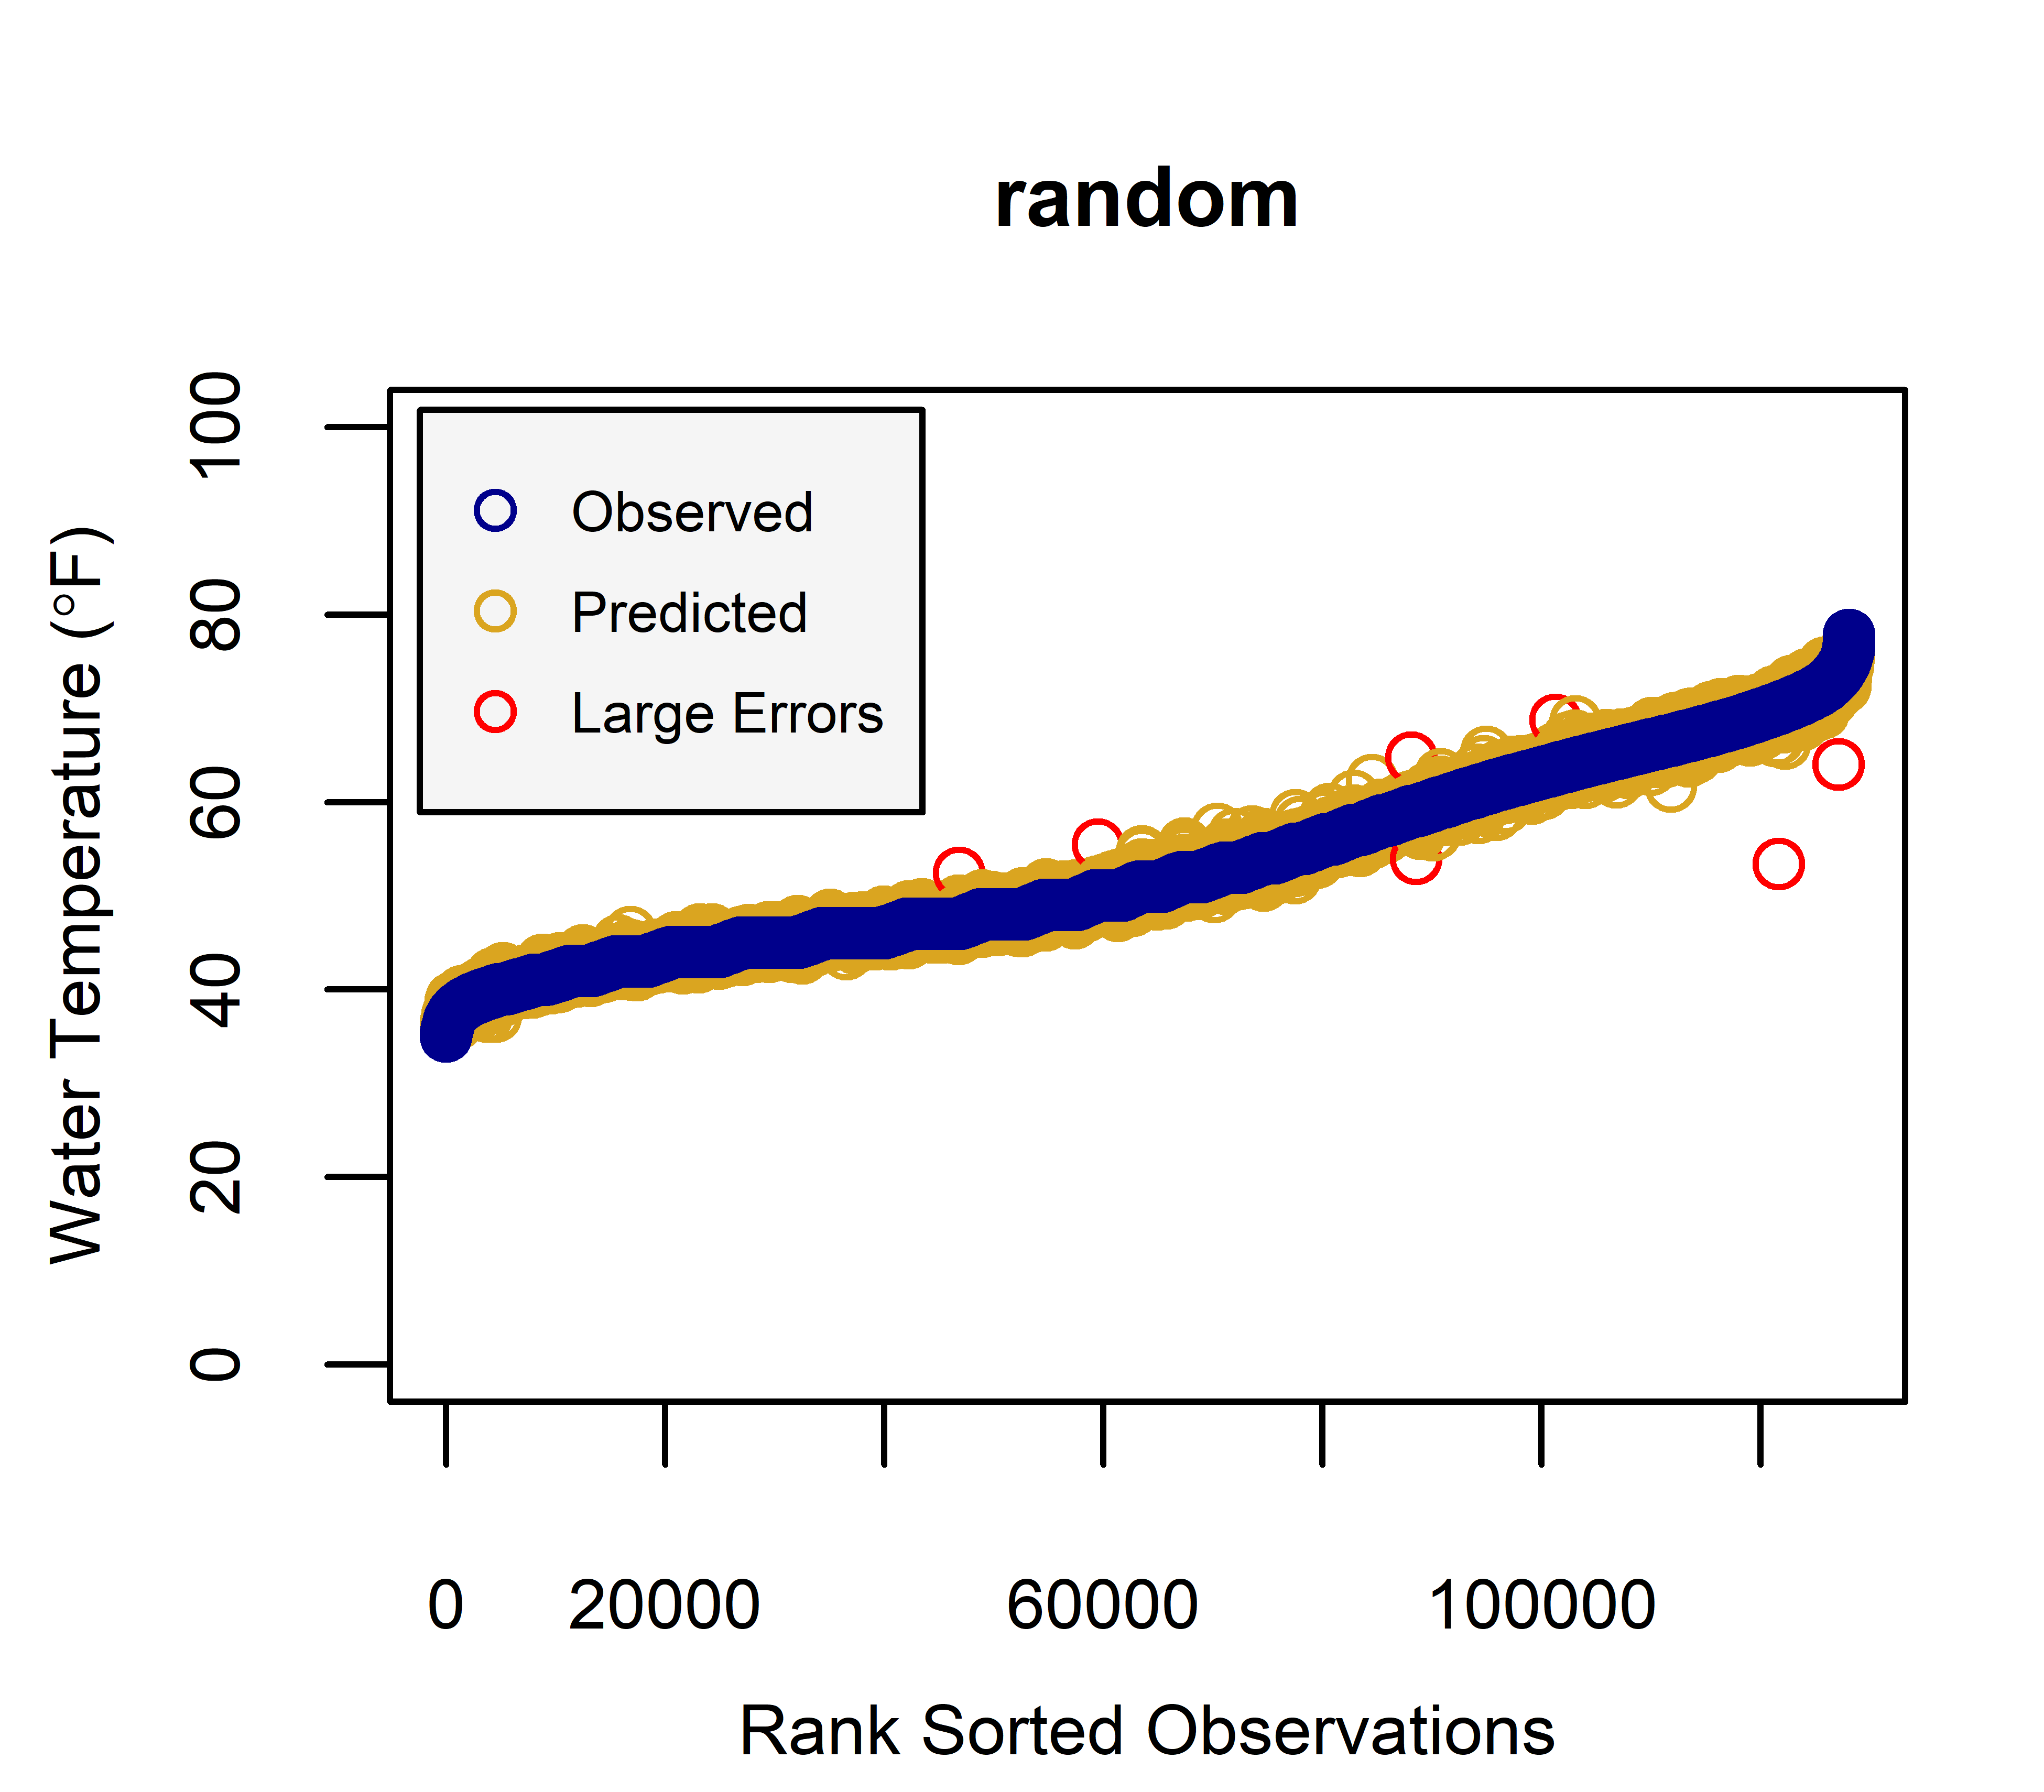
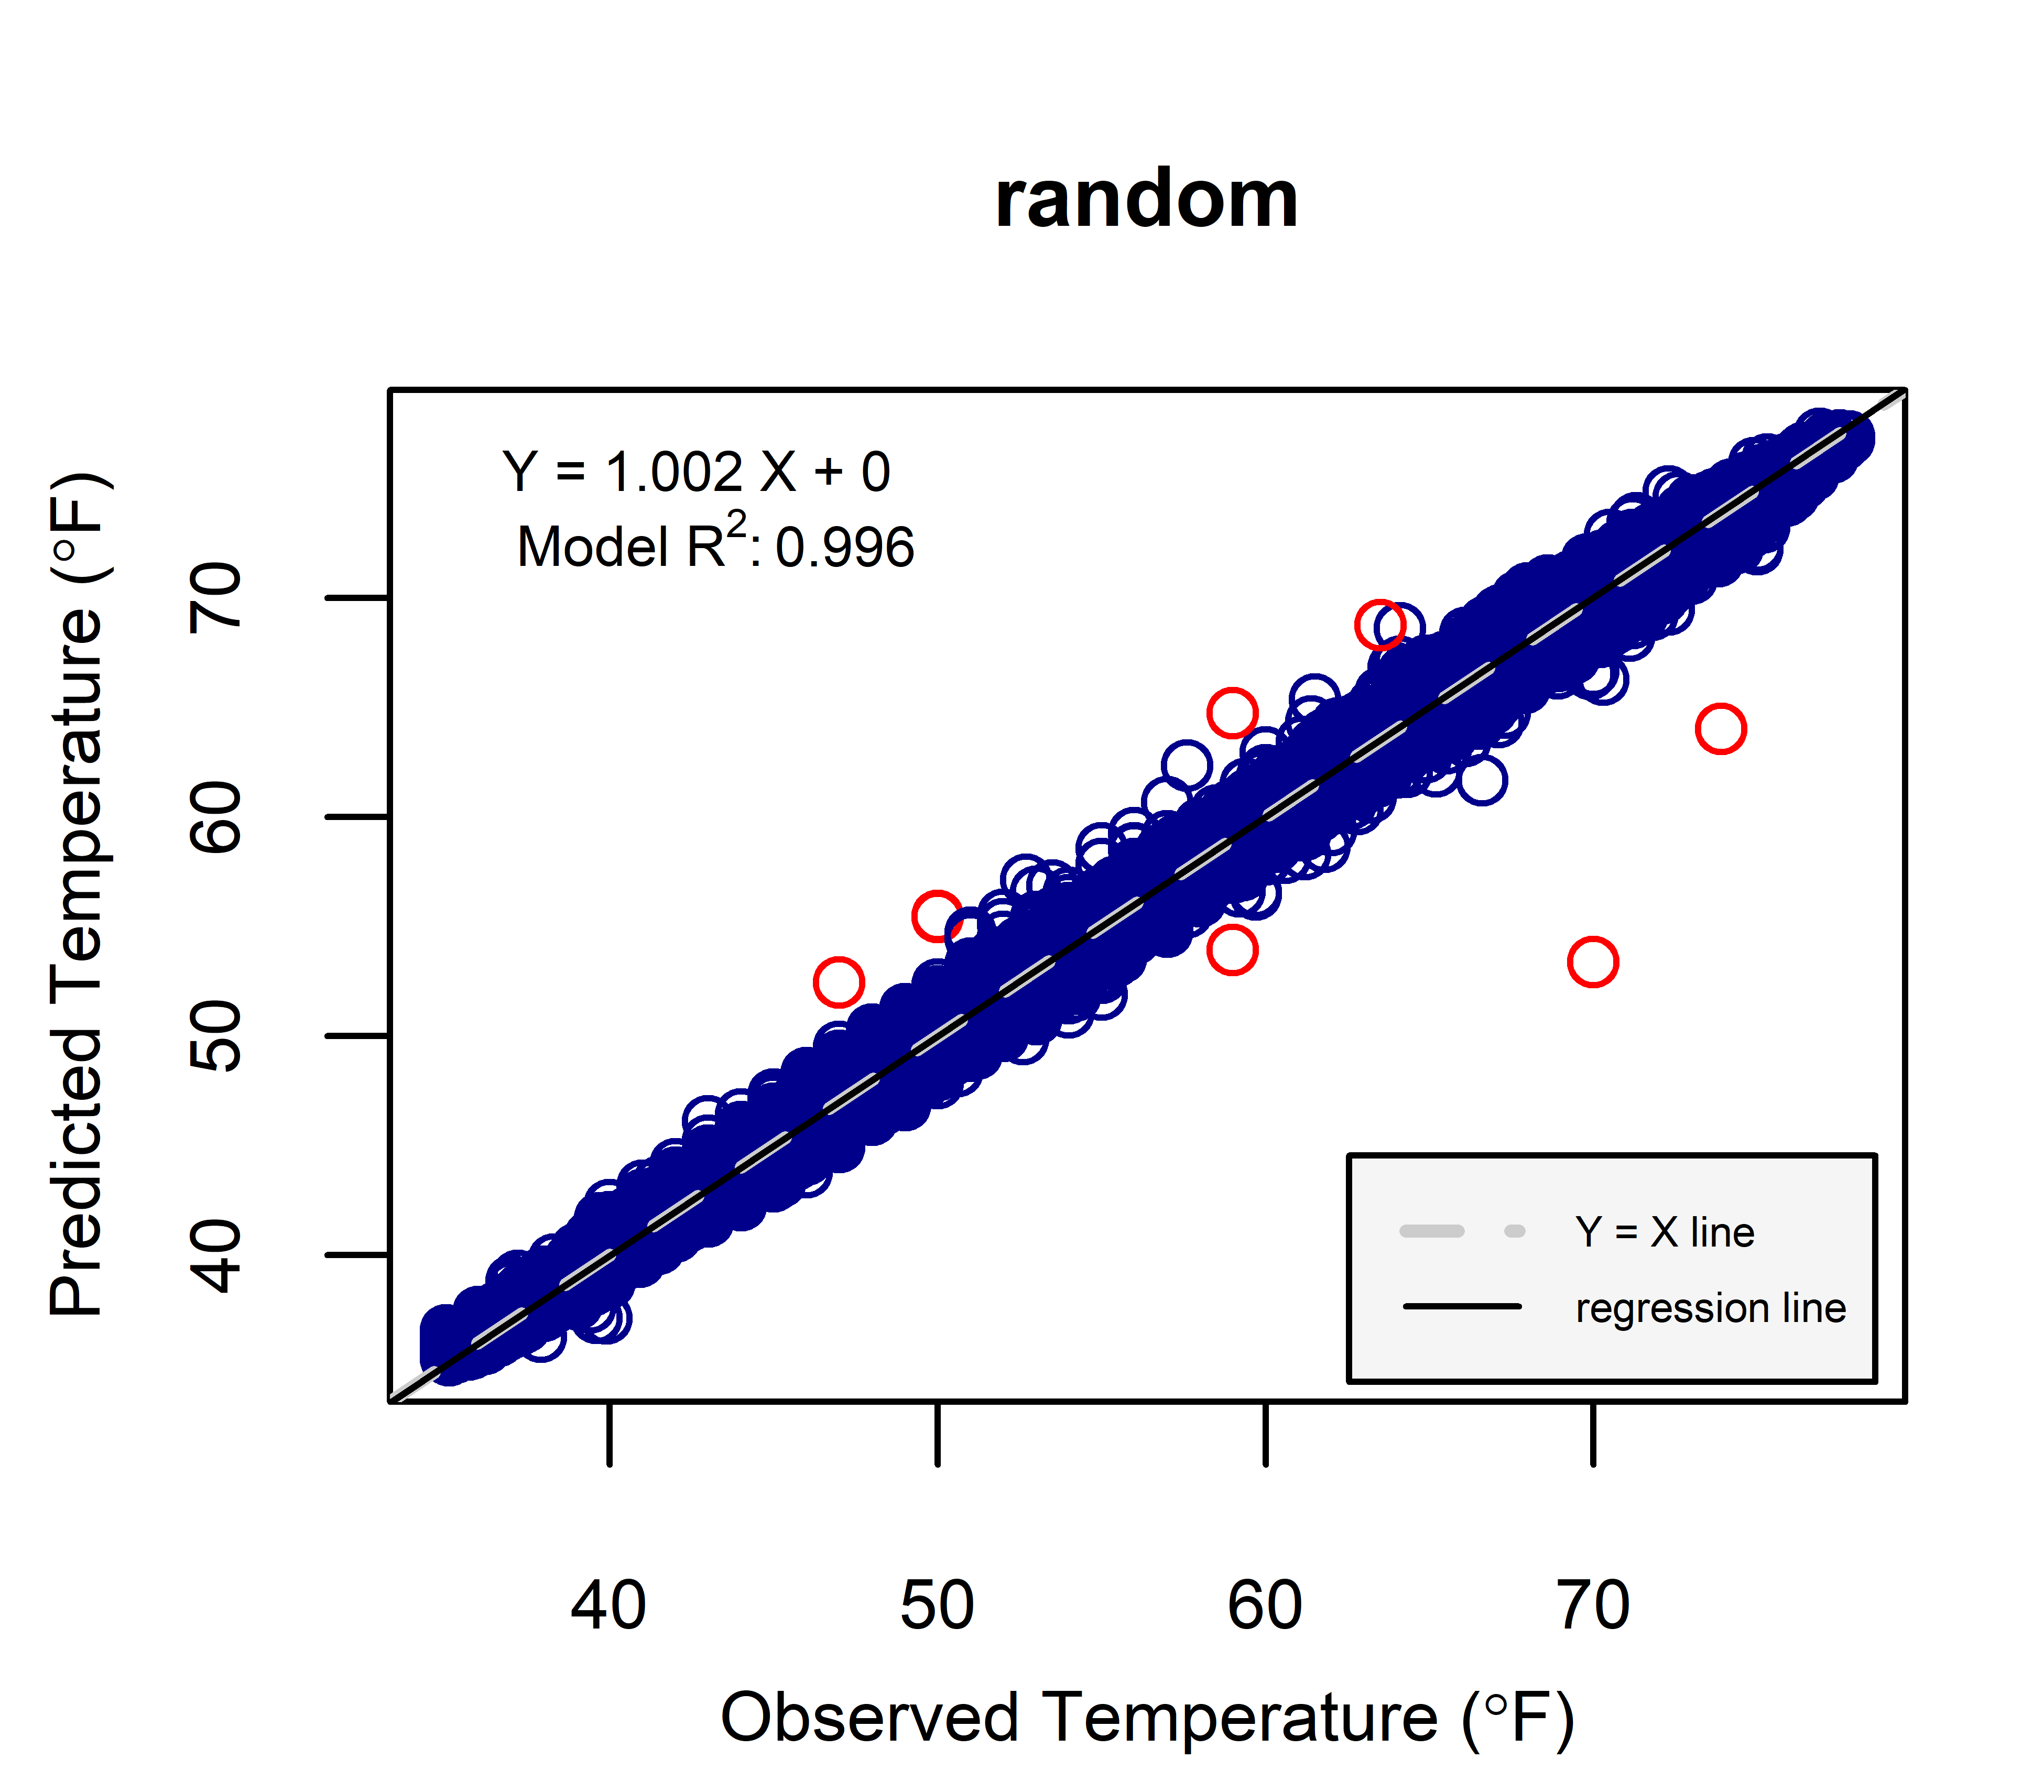
Results: Random Forest

Slide 16
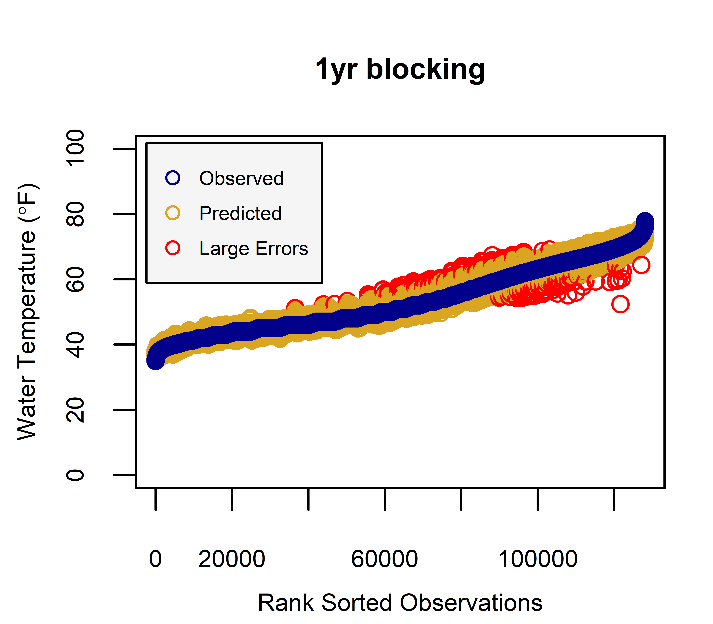
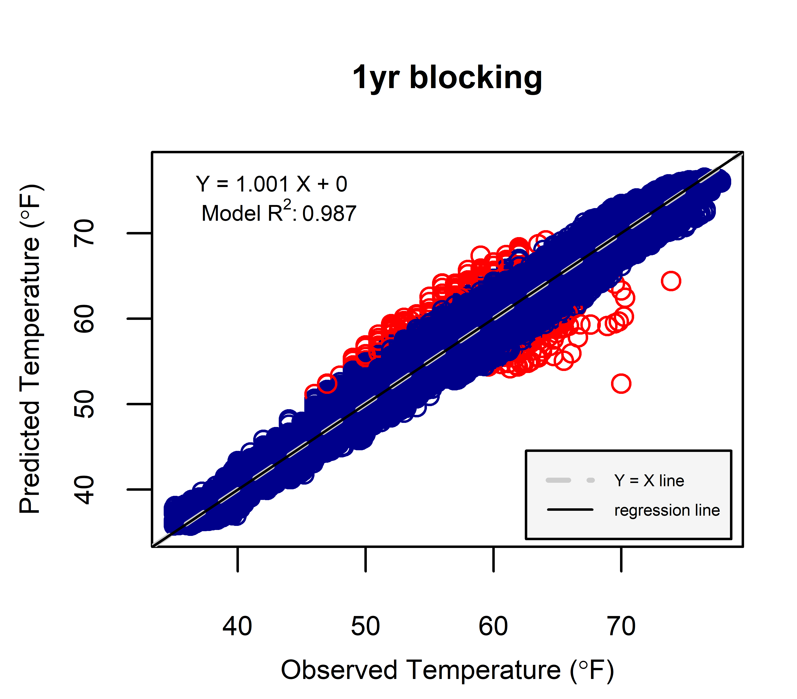
Results: Random Forest

Slide 17

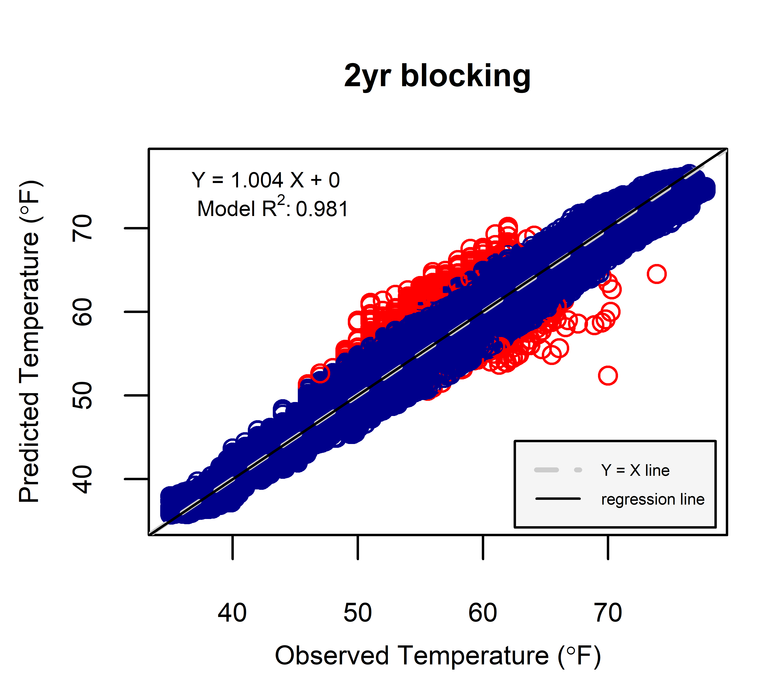
Results: Random Forest

Slide 18
Results: Random Forest

Slide 19
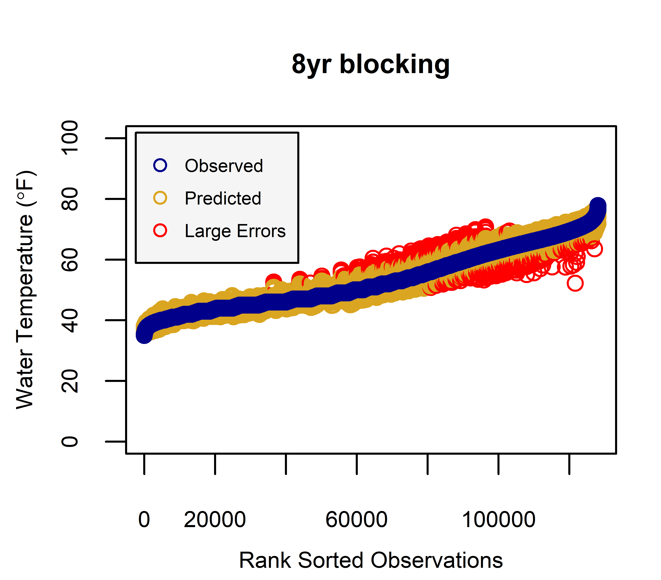
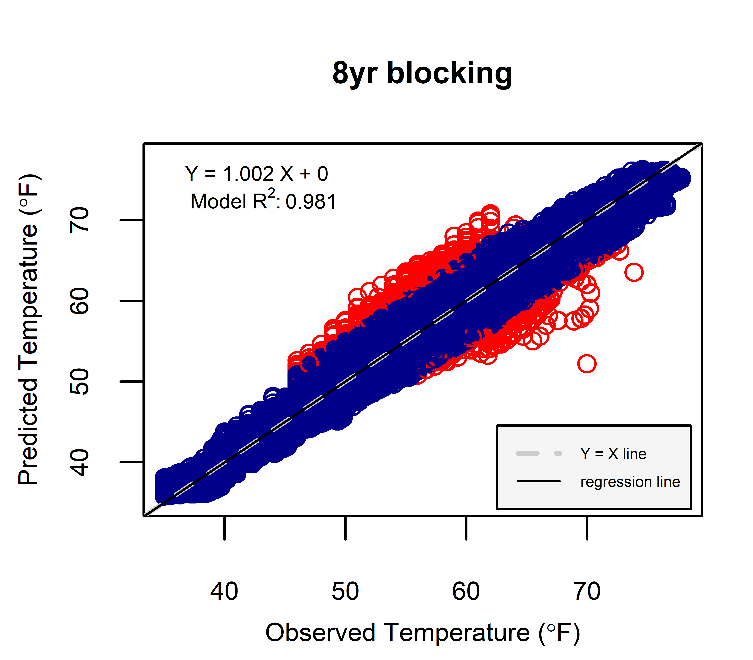
Results: Random Forest

Slide 20
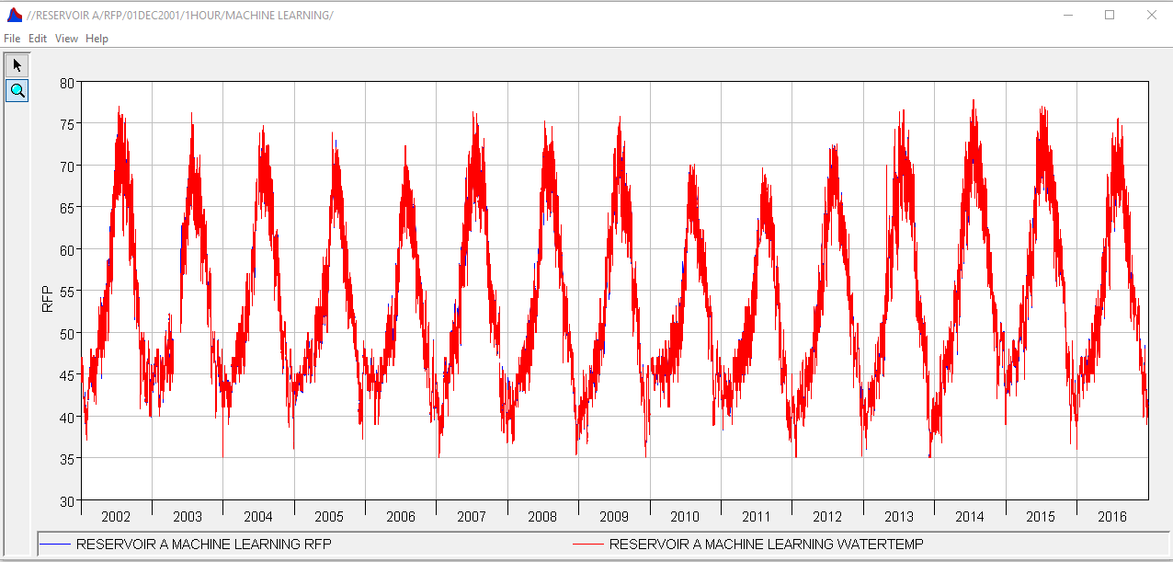
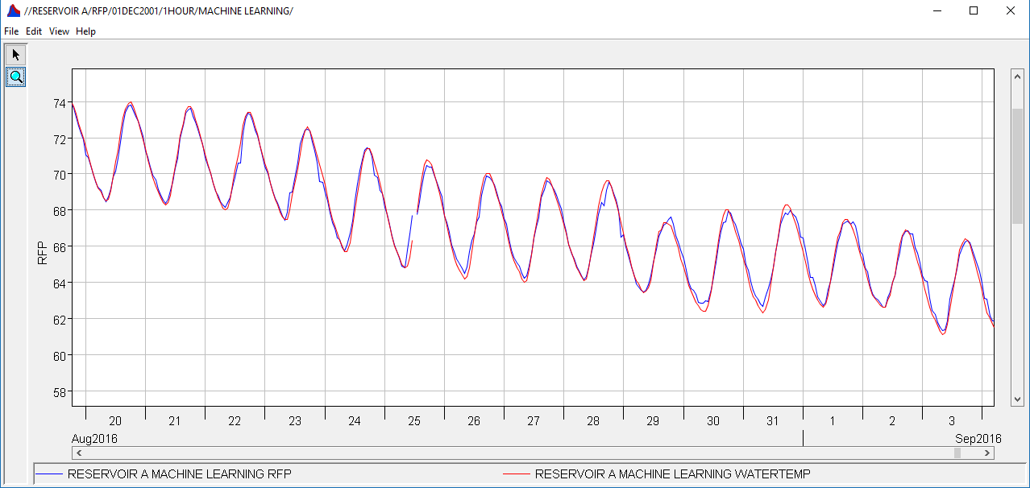
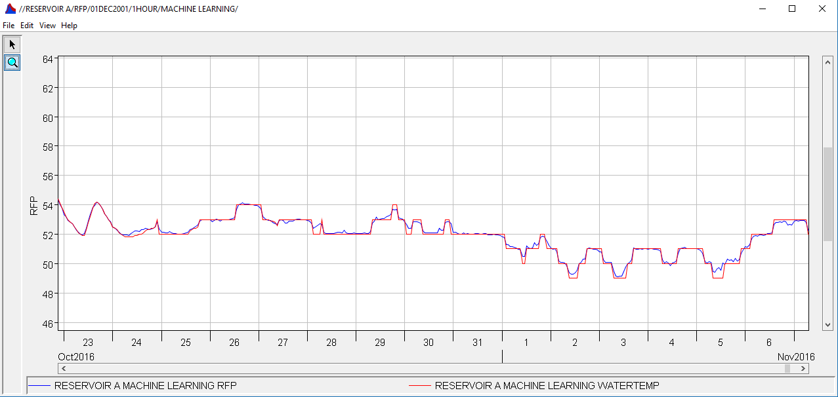
Results: Random Forest
Predictions
Observations

Slide 21
Results: Model Fit
R2 (Coefficient of Determination): 0.995
RMSE (Root Mean Square Error): 0.758 ºF
RSR (RMSE standard deviation ratio): 0.069
NSE (Nash-Sutcliffe Efficiency): 0.995
PBIAS (Percent Bias): 0.024 %
Find in the literature what constitutes a good model…

Slide 22
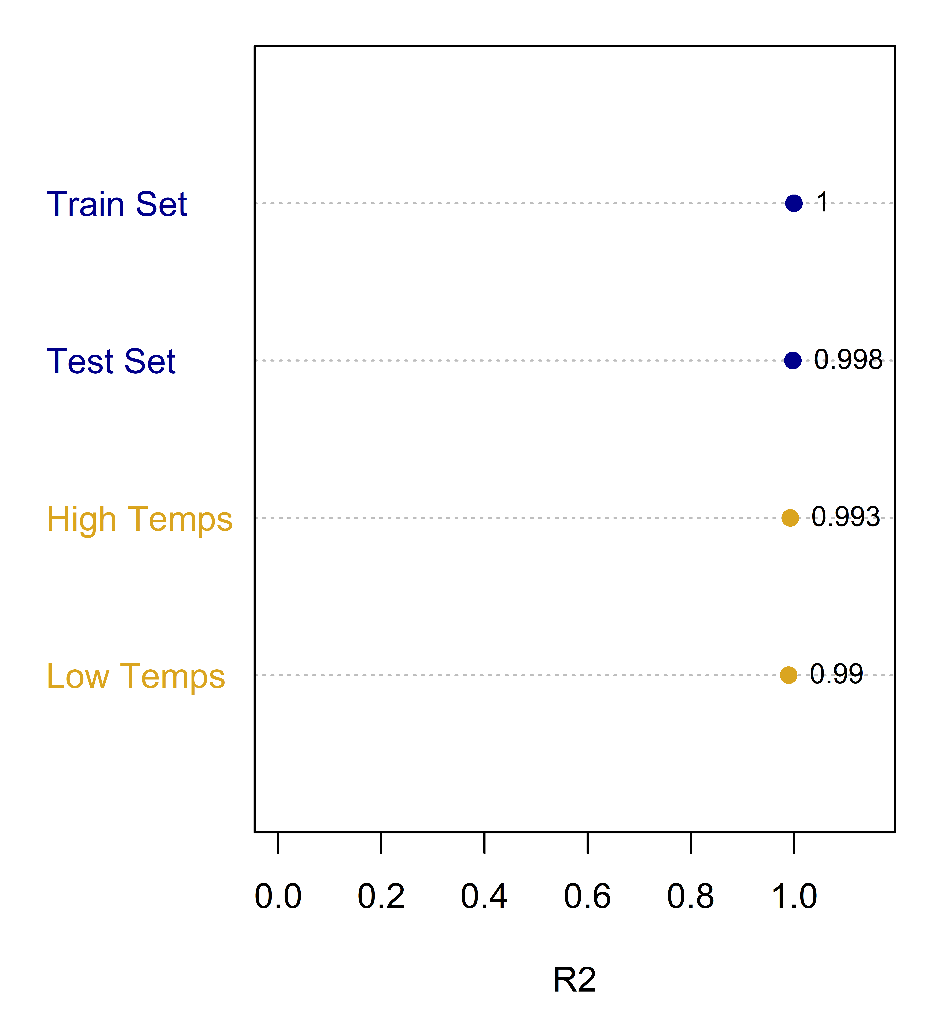
Results: Model Fit
Categories to diagnose:
Overfitting problem?
Low temp problem?
High temp problem?

Slide 23
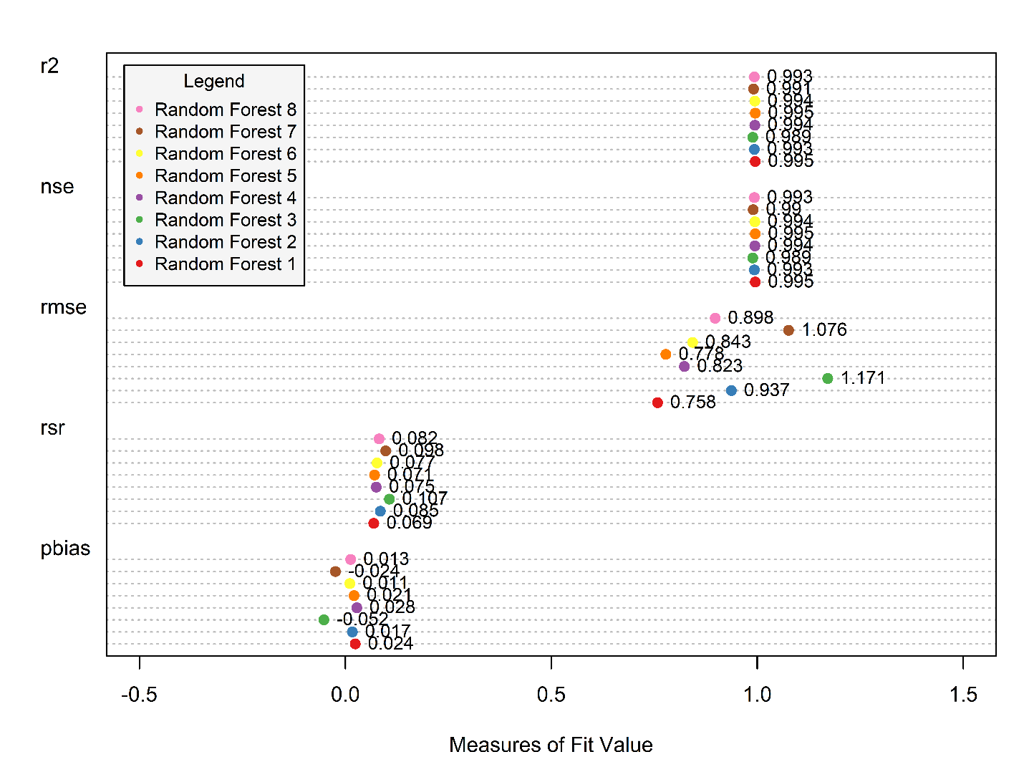
Model Modifications
R2
NSE
RMSE
RSR
PBIAS

Slide 24
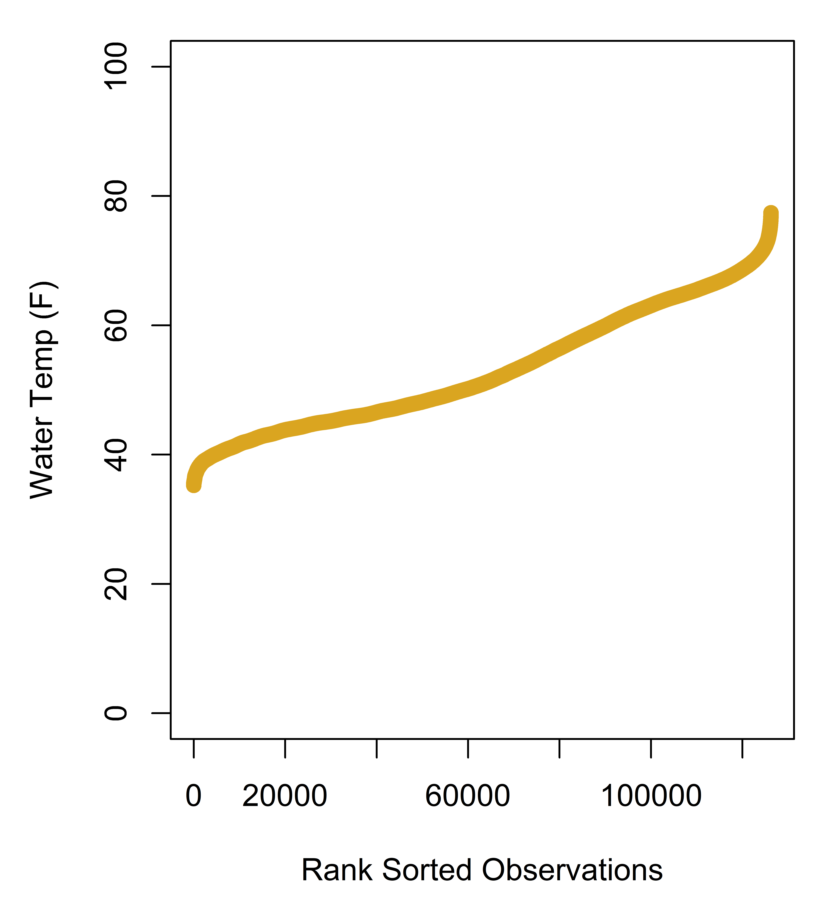
Next Step
New data:
Trinity River
Test these predictions against HEC5Q
Q1) Can machine-learning models give better and more cost effective streamflow temperature predictions for drought, flood and water management applications compared to mechanistic models?

Slide 25

Conclusions
Statistical learning models enable us to make models that are
Quick to build/run
Easy to use
Just based on the data
Because of the good fit this method can be applied to other California basins
Next steps: model improvement
Spatial autocorrelation of the residuals
Spatially distributed R² values
Lower the dimensionality
by J. J. SEMPÉ

Slide 26
Citations (Incomplete)
R Core Team (2017). R: A language and environment for statistical computing. R Foundation for Statistical Computing, Vienna, Austria. URL https://www.R-project.org/ . R version 3.4.0 (2017-04-21) -- "You Stupid Darkness"
Taiyun Wei and Viliam Simko (2016). corrplot: Visualization of a Correlation Matrix. R package version 0.77. https://CRAN.R-project.org/package=corrplot
Pebesma, E.J., R.S. Bivand, 2005. Classes and methods for spatial data in R. R News 5 (2), https://cran.r-project.org/doc/Rnews/ .
Roger S. Bivand, Edzer Pebesma, Virgilio Gomez-Rubio, 2013. Applied spatial data analysis with R, Second edition. Springer, NY. http://www.asdar-book.org/
Terry Therneau, Beth Atkinson and Brian Ripley (2017). rpart: Recursive Partitioning and Regression Trees. R package version 4.1-11. https://CRAN.R-project.org/package=rpart
A. Liaw and M. Wiener (2002). Classification and Regression by randomForest. R News 2(3), 18--22.
Robert J. Hijmans (2016). raster: Geographic Data Analysis and Modeling. R package version 2.5-8. https://CRAN.R-project.org/package=raster
Roger Bivand and Colin Rundel (2017). rgeos: Interface to Geometry Engine - Open Source (GEOS). R package version 0.3-23. https://CRAN.R-project.org/package=rgeos
Roger Bivand, Tim Keitt and Barry Rowlingson (2017). rgdal: Bindings for the Geospatial Data Abstraction Library. R package version 1.2-7. https://CRAN.R-project.org/package=rgdal
Edmund M. Hart and Kendon Bell (2015) prism: Download data from the Oregon prism project. R package version 0.0.6 http://github.com/ropensci/prism DOI: 10.5281/zenodo.33663
USDA-NRCS Soil Survey Staff (2016). sharpshootR: A Soil Survey Toolkit. R package version 1.0. https://CRAN.R-project.org/package=sharpshootR
Hadley Wickham (2007). Reshaping Data with the reshape Package. Journal of Statistical Software, 21(12), 1-20. URL http://www.jstatsoft.org/v21/i12/ .
Nathaniel W. Chaney, Eric F. Wood, Alexander B. McBratney, Jonathan W. Hempel, Travis W. Nauman, Colby W. Brungard, Nathan P. Odgers, POLARIS: A 30-meter probabilistic soil series map of the contiguous United States, Geoderma, Volume 274, 15 July 2016, Pages 54-67, ISSN 0016-7061, https://doi.org/10.1016/j.geoderma.2016.03.025.
Flint, L. E., Flint, A. L., Thorne, J. H., & Boynton, R. (2013). Fine-scale hydrologic modeling for regional landscape applications: the California Basin Characterization Model development and performance. Ecological Processes, 2(1), 25. https://ecologicalprocesses.springeropen.com/articles/10.1186/2192-1709-2-25

Slide 27

Questions?
by A. GETZ

Slide 28
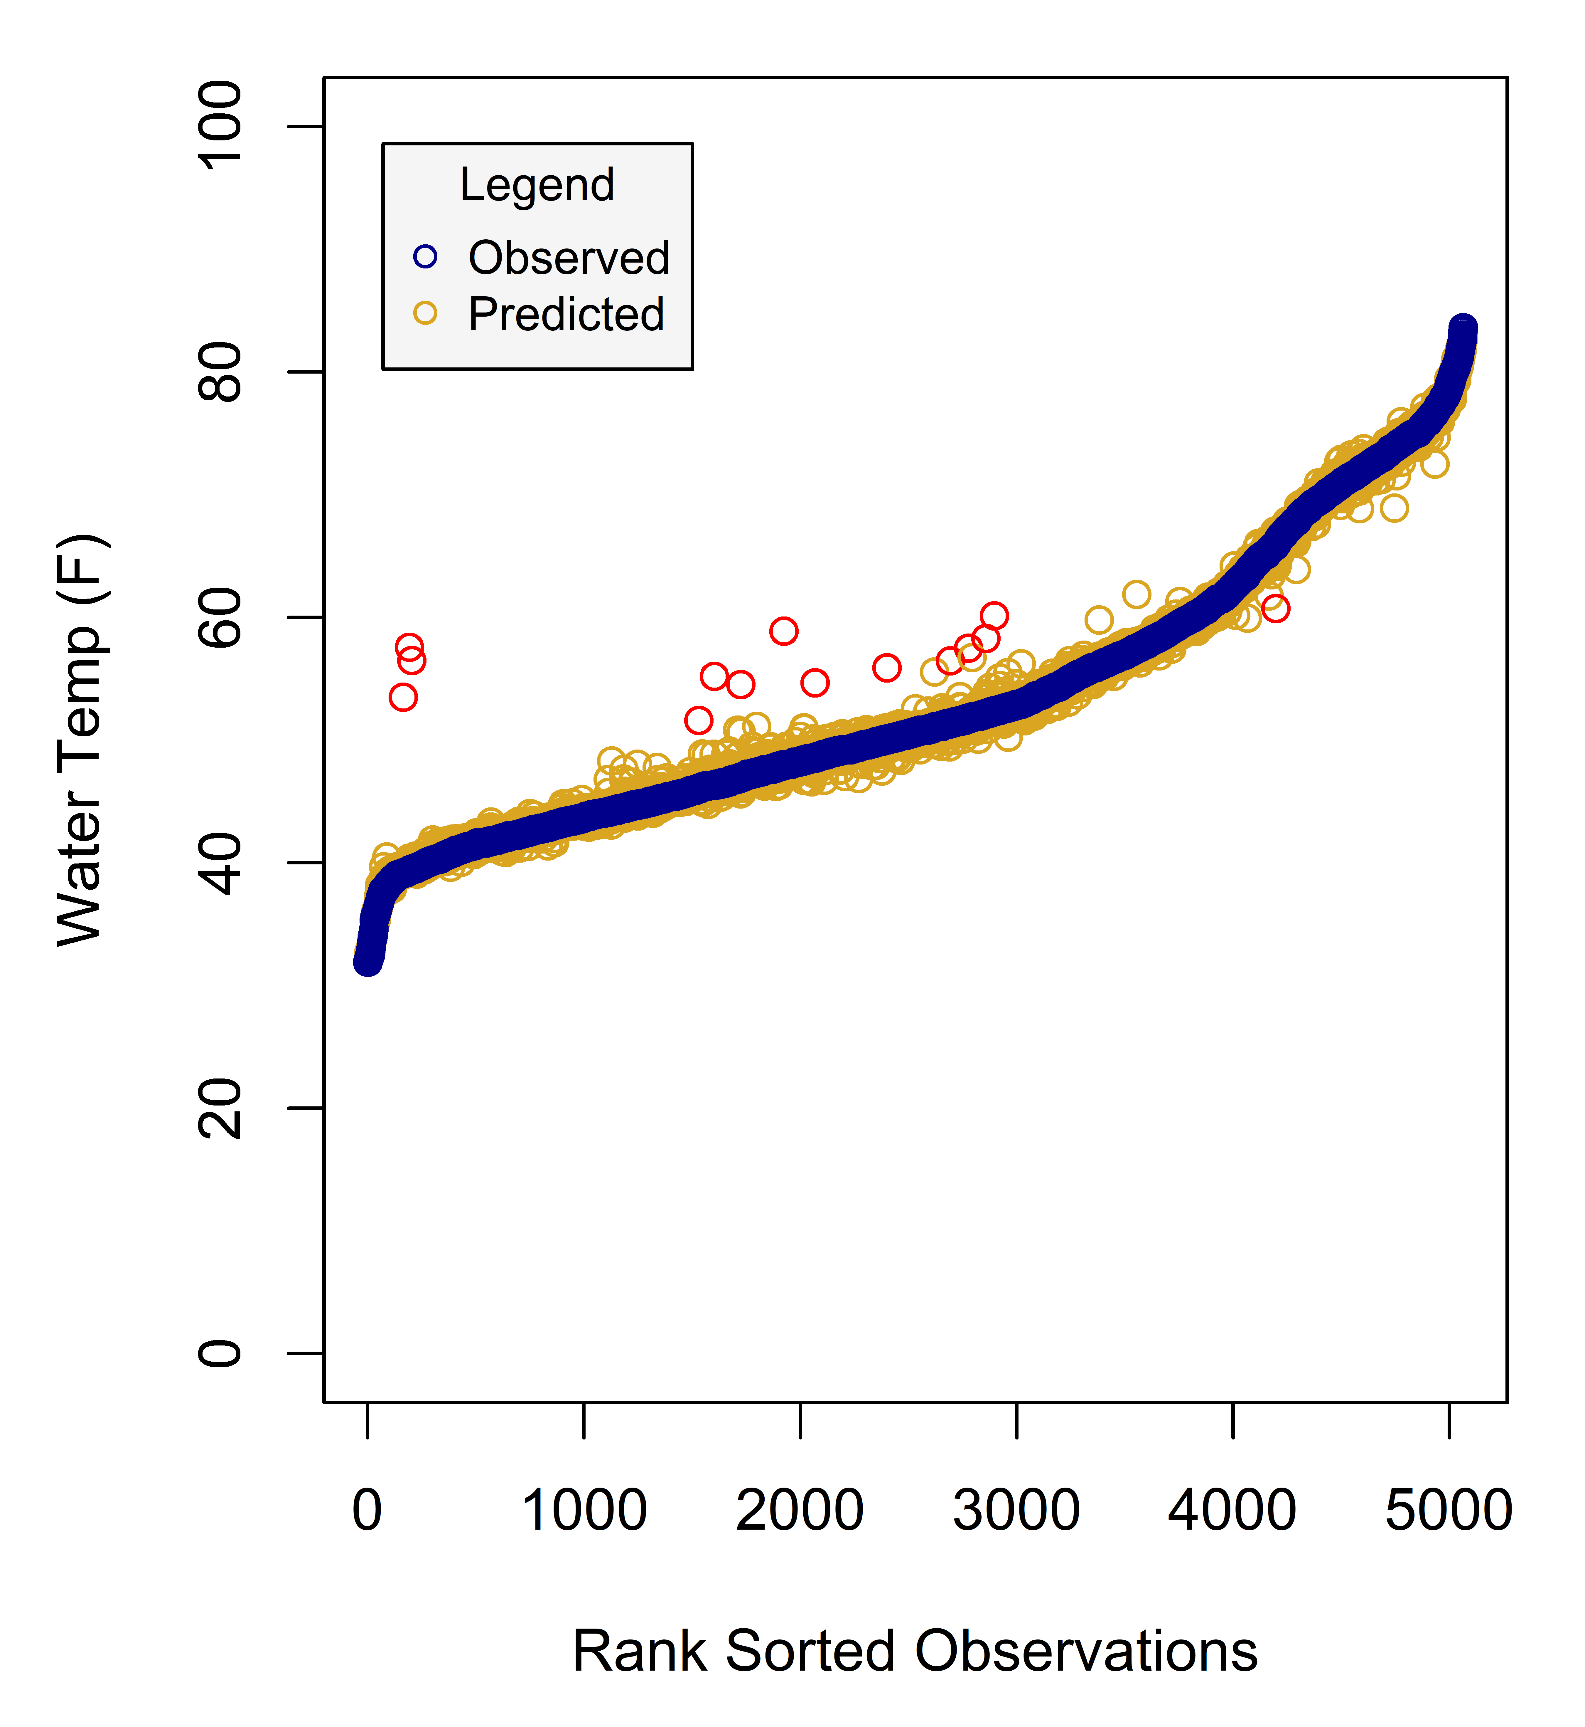
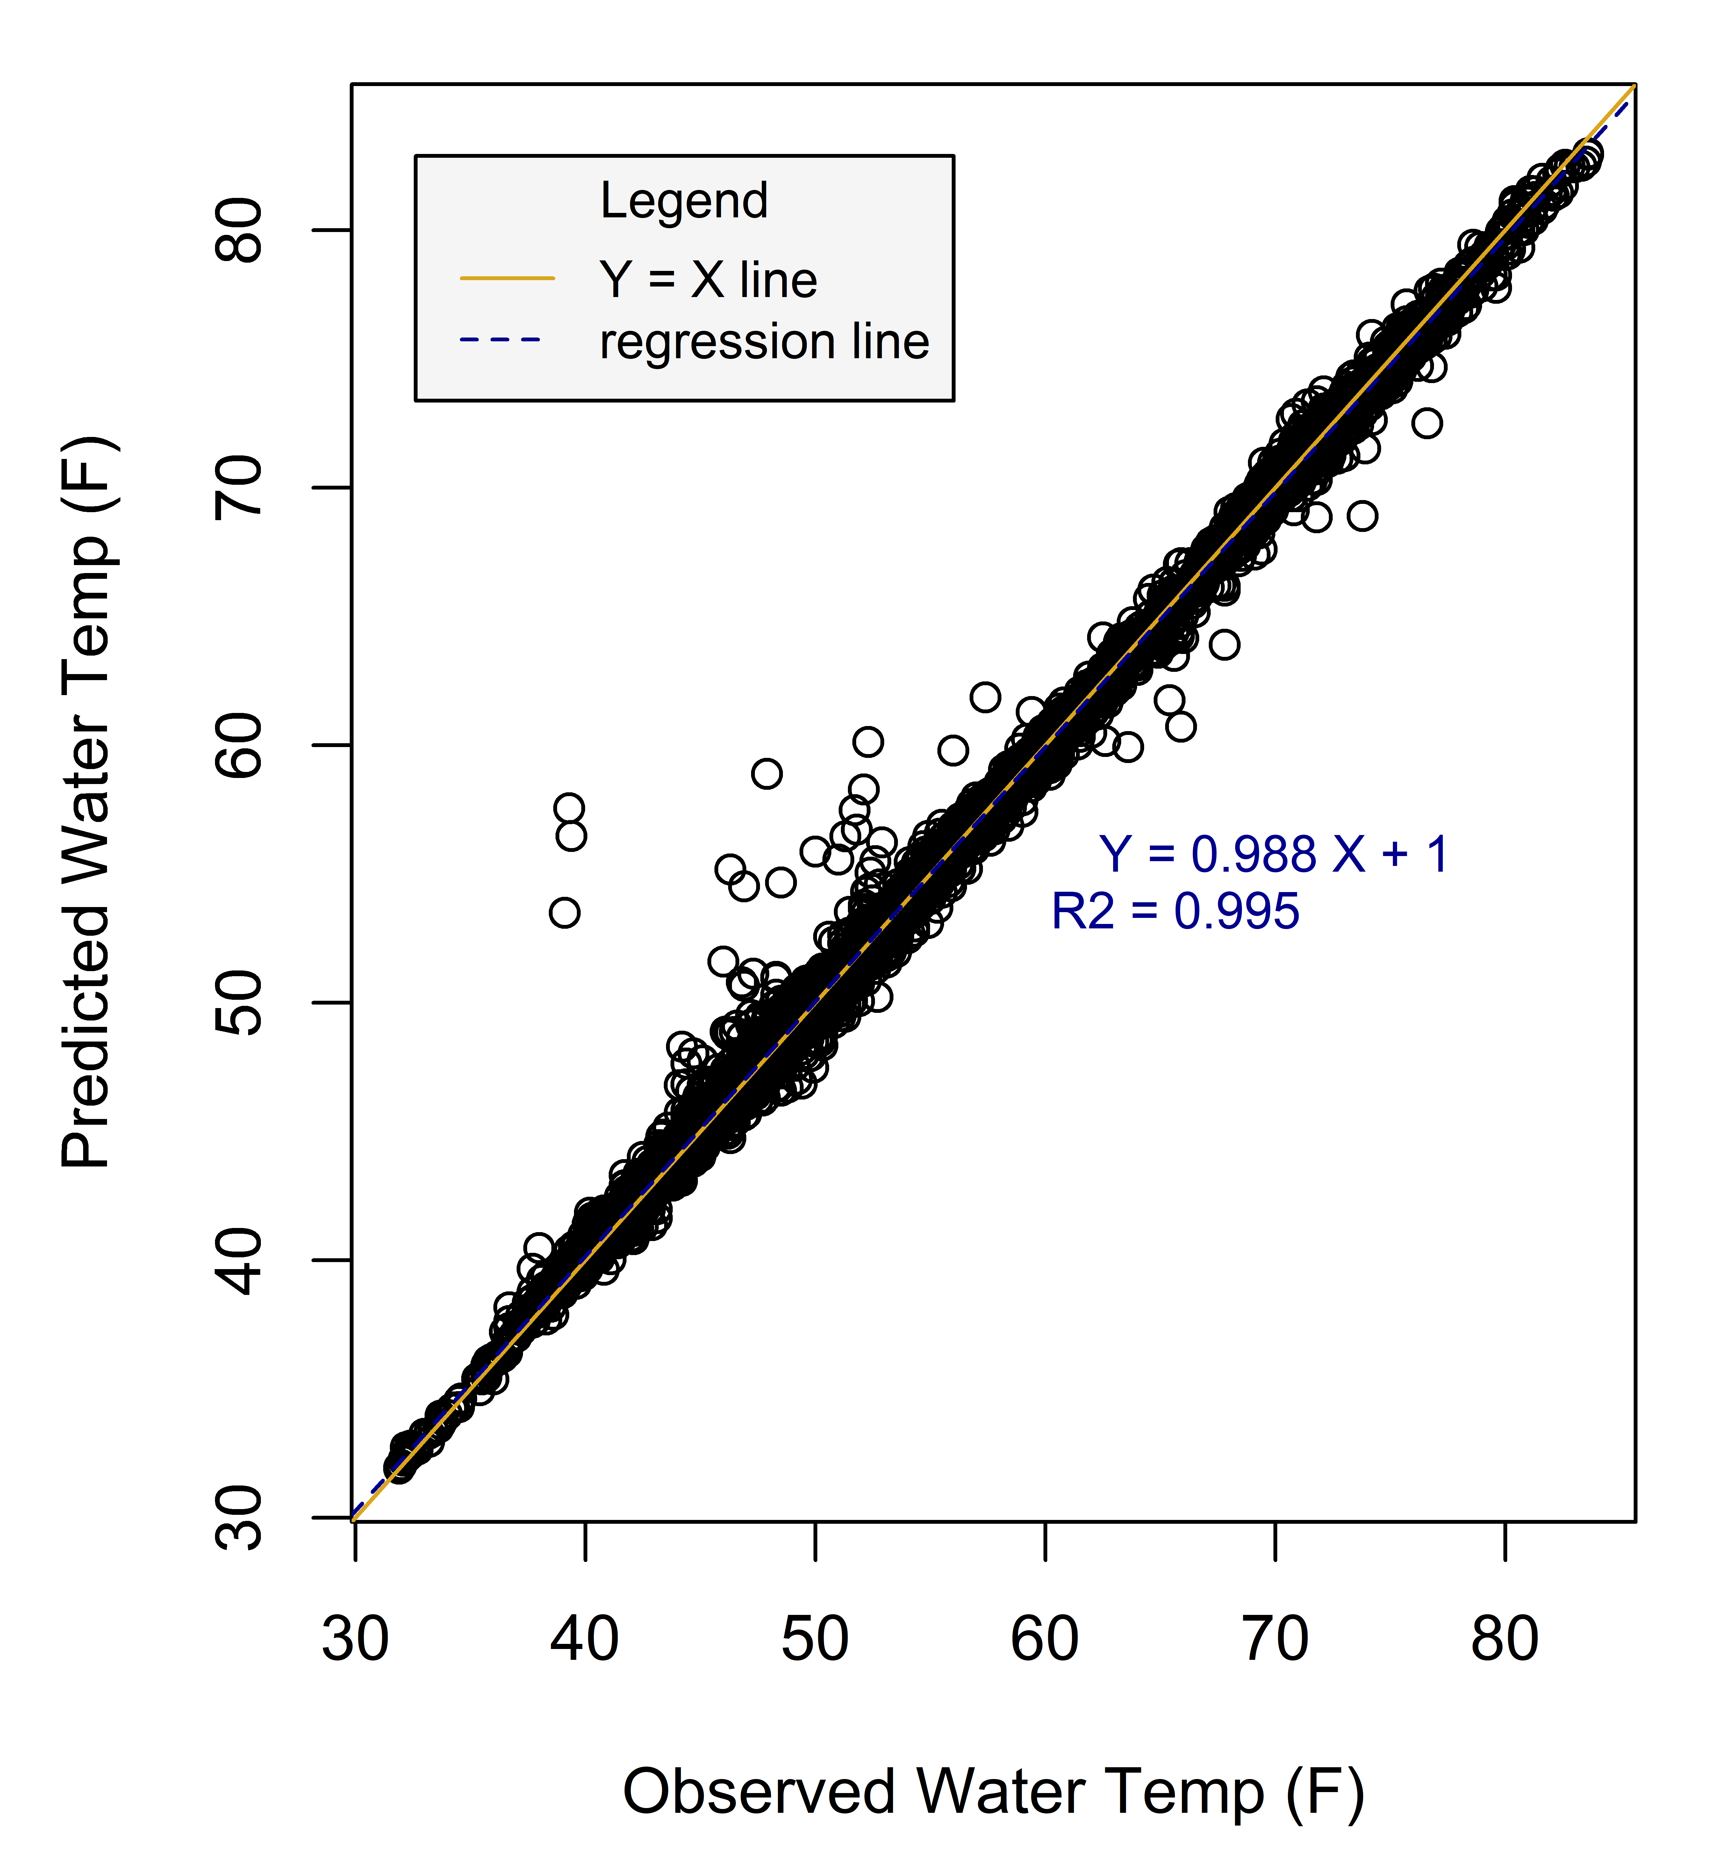
Merced River

Slide 29

Relevant(?!) xkcd
Goodness of Split
Notes:
Doing that will more than likely not help the performance of the model. What makes the data speak is the process. adding noise features that are not truly associated with the response will lead to a deterioration in the fitted model, and consequently an increased test set error. This is because noise features increase the dimensionality of the problem, exacerbating the risk of having trees in the forest that do not make splits on the variables we know better describe flow.

Slide 30
CART: Tree Size

Slide 31
Results: Model Fit
R2
RMSE
NSE
RSR
PBIAS

Slide 32
Next Steps (1 of 4)
Develop the recurrent neural network (RNN) model
Standardize the data: make sure the right transformations are chosen.
Pick the correct number of hidden nodes and epochs. The upwards and downwards paths of the predictions following the observations may be easy to tweak, while hitting the peaks and valleys may be problematic.
Fit the RNN.
Evaluate and iterate.
The Long short-term memory (LSTM) is a recurrent neural network (RNN) but better at keeping events “in memory”. Try this if needed.
Report performance on different epochs (make it a gif, could be cool to see how the model’s predictions converge the longer you let it run).

Slide 33
Next Steps (2 of 4)
Develop the auto-regressive integrated moving average (ARIMA) model
Decompose the seasonality, trends and cyclical components of the data: Use decompose() or stl() to examine and possibly remove components of the time series data.
Stationarity: Use adf.test(), ACF, PACF plots to determine order of differencing needed.
Autocorrelations: examine plots and determine the model order.
Fit ARIMA: read up on the Box-Jenkins method of fitting so you know what’s going on.
Evaluate and iterate.
Develop the transfer function model instead (?)

Slide 34
Next Steps (3 of 4)
Develop the ungauged basin problem
Gathering data for CDEC basins (Don may have all of this cleaned up already).
Processing spatial data.
Cleaning up dataframe and prep for ml.
Using the LOGOCV method to perform the ml for each basin.
Benchmarking: Compare the performance to a process based model (probably something that Don already has (predicted datasets)).

Slide 35
Next Steps (4 of 4)
Comparison of the different machine learning methods
Based on relevant measures of fit (find this in literature, Moriasi/EPA may have laid this out already).
Based on # of outliers only (this will give a different flavor to the problem; here, the performance metric is just for the predictions to not be too far off, which is useful when complying with regulations is concerned). Also, can try to find a performance metric that is sensitive to outliers (consult with the statistics department at ucd).
Benchmarking: Can include the process-based model in comparisons too.

